Slide 1
Chapter 3

Slide 2
I The Politics of Empire, 1660–1713
A. The Restoration Colonies
Charles II gave the Carolinas to his aristocratic friends.
Brother James, the Duke of York, received land between the Delaware and Connecticut Rivers.
James took possession of New Netherland and
New York; the adjacent land was established as New Jersey.
The Fundamental Constitutions of Carolina (1669) prescribed a manorial system with nobility and serfs. Slavery mentioned in charter.
Poor families in North Carolina refused to work on large manors and chose to live on modest farms.

Slide 3
A. The Restoration Colonies
7. South Carolina remained an ill-governed and
violence-ridden frontier settlement.
8. Blackbeard’s raid 1712
9. Northern portion became North Carolina in 1712.
10 Cattle raising and deerskin trading were very profitable.
11 Settlers engaged in trade in Native American slaves.
12 Early fortunes later invested in rice plantations

Slide 4
A.1. Restoration Colonies North of Virginia
New York established in 1664.
Won through seizure of New Netherlands.
Southern portion became New Jersey.
Dutch and English coexisted peacefully throughout colonial era.
Primarily engaged in trade of beaver furs; later export of wheat and corn.

Slide 5
A.2. Restoration Colonies North of Virginia
1. The Quaker Colonies: PA + DE
2. The Society of Friends = QUAKERS
3. Pennsylvania established in 1681.
4. Quaker colony that welcomed settlers of all faiths.
5. First Frame of Government in 1682 guaranteed religious freedom.
6. Took care to purchase land from the Delawares rather than taking it.
7. America's breadbasket” during eighteenth century.

Slide 6
A.2. Restoration Colonies North of Virginia
8. Holy Experiment
9. Peace = Land bought from Indians - No Militia
10 Good relations with Indians
11 Toleration
12 Means a model of prosperity
13 Amish - Mennonites - Germans of all kinds

Slide 7
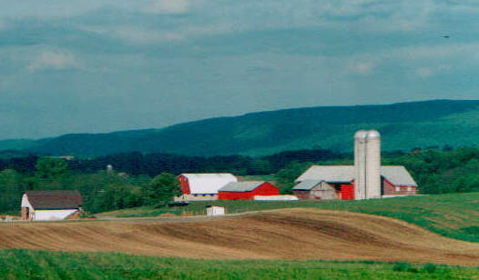
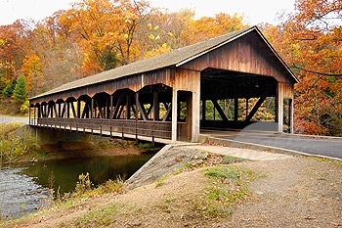
Amish Life

Slide 8
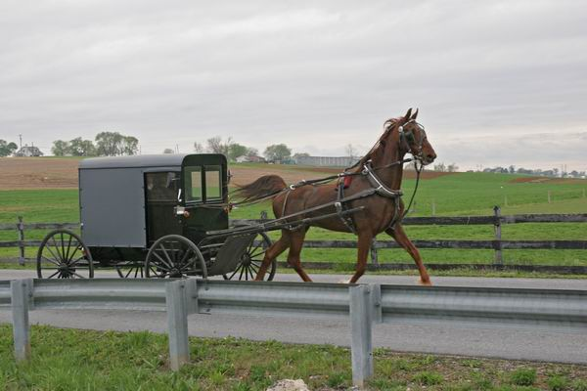
Amish Life

Slide 9
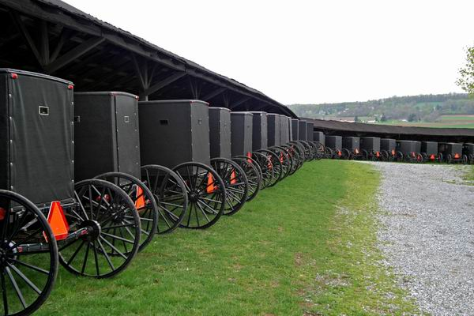
Amish Life

Slide 10
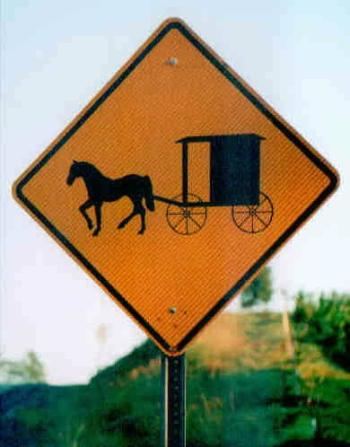
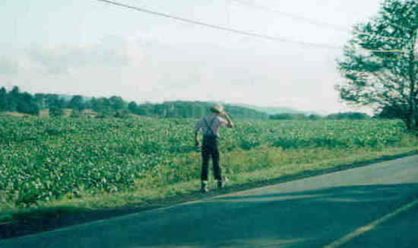
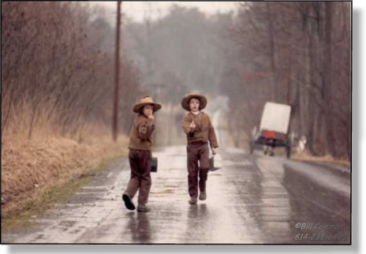
Amish Life

Slide 11
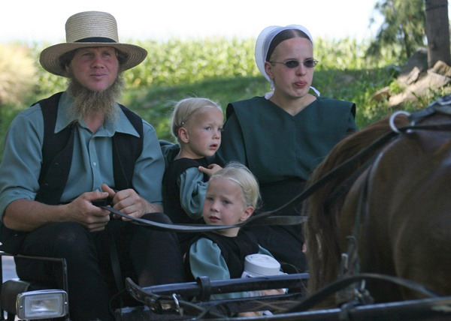
Amish Life

Slide 12
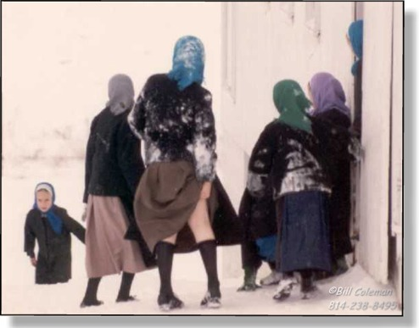
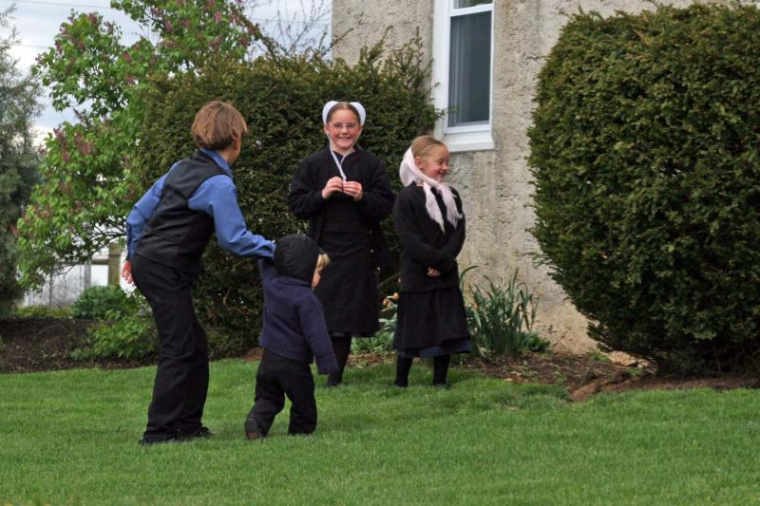
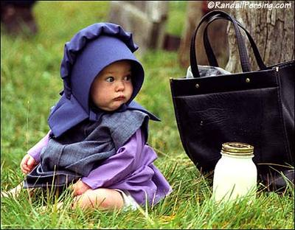
Amish Life

Slide 13
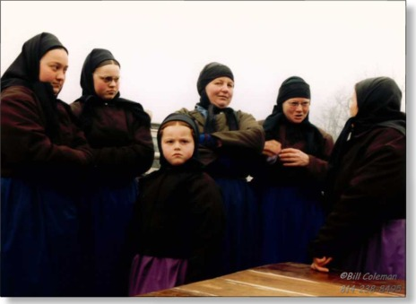

Amish Life

Slide 14
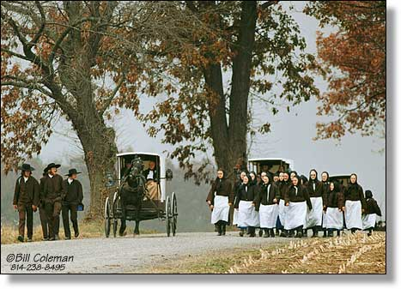
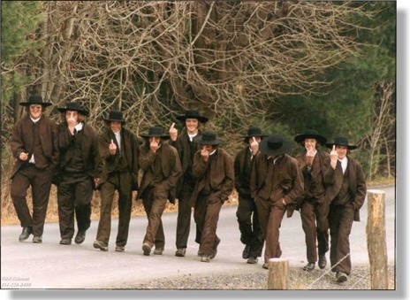
Amish Life

Slide 15
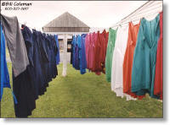
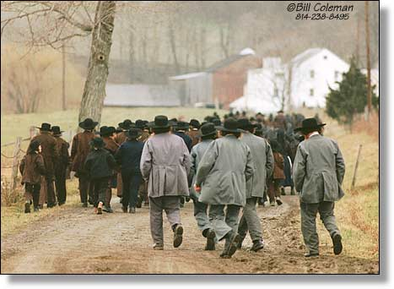

Amish Life

Slide 16
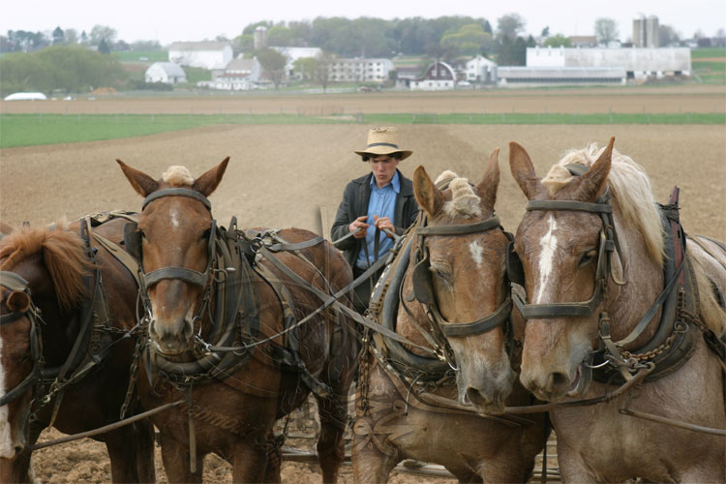
Amish Life

Slide 17
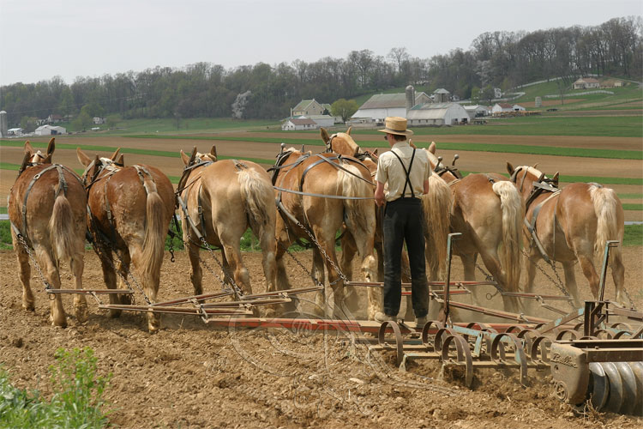
Amish Life

Slide 18
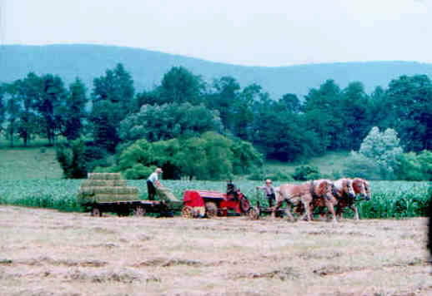
Amish Life

Slide 19
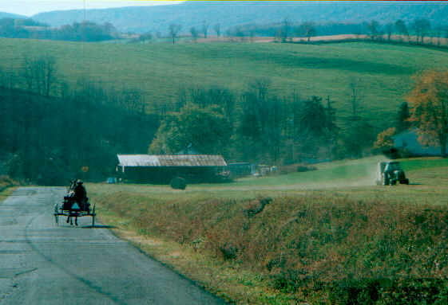
Amish Life

Slide 20
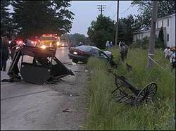
Amish Life

Slide 21
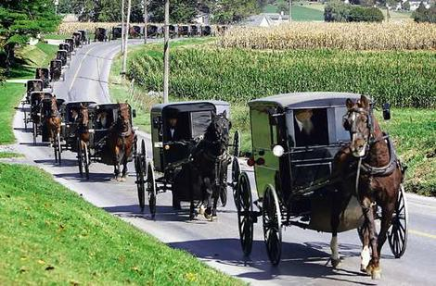
Amish Life

Slide 22
B. From Mercantilism to Dominion
In the 1650s the English government imposed mercantilism, via the Navigation Acts
Regulated colonial commerce and manufacturing.
The Revenue Act of 1673 imposed a “plantation duty” on sugar and tobacco exports and created a staff of customs officials to collect it.
In commercial wars between 1652 and 1674, English ended Dutch supremacy in the West African slave trade.
The English also dominated Atlantic commerce.
6. Many Americans resisted the mercantilist laws

Slide 23
B. From Mercantilism to Dominion
7. When James II succeeded to the throne, - insistence on the “divine right” of kings prompted English officials to create a centralized imperial system in America.
8. In 1686 the CN, RI, MBC, Plymouth = Dominion of New England
9. Glorious Revolution ends Dominion of New England

Slide 24
C. The Glorious Revolution of 1688
In 1688, James’s Catholic wife gave birth to a son--- Catholic heir to the throne?
2. Protestant Parliamentary leaders carried out a bloodless coup.
3. Mary, James’s Protestant daughter by his first wife, and her husband William of Orange
4. Queen Mary II and William III accepted a Bill of Rights that limited royal prerogatives and increased personal liberties and parliamentary powers.

Slide 25
D. Imperial Wars and Native Peoples
1689 - 1815, Britain and France fought wars for dominance of W. Europe.
These wars involved a number of Native American warriors armed with European weapons.
3. The War of the Spanish Succession (1702–1713) pitted Britain against France and Spain.
4. So that they might help to protect their English settlement, whites in the Carolinas armed the Creek peoples to fend off French and Spanish attacks.

Slide 26
D. Imperial Wars and Native Peoples
5. Native Americans also played a central role in the fighting in the Northeast
6. Aided by the French, the Abnakis and Mohawks took revenge on the Puritans attacking settlements in Maine and Massachusetts.
7 New Englanders responded by joining British forces in attacks on French strongholds in Nova Scotia and Quebec.
8. The New York frontier remained quiet due to the fur trade and the Iroquois’ policy of “aggressive neutrality”: trading with the British and the French but refusing to fight for either side.

Slide 27
II. The Imperial Slave Economy
A. The Atlantic Slave Trade
labor for the sugar plantations
British and French developed African-run slave-catching systems into nterior of Africa
3. 10,000 Africans per year to the Americas
4. 1750 re-exports of American sugar and tobacco accounted for half of all British exports.
5. The South Atlantic system brought wealth to the European economy, brought economic decline, political change, and human tragedy to West Africa

Slide 28
A. The South Atlantic System
6. African slaves who were forced to endure the “Middle Passage” suffered the bleakest fate; many were literally worked to death on the sugar plantations.

Slide 29
B. Slavery in the Chesapeake and South Carolina
After 1700, planters in Virginia and Maryland imported thousands of slaves and created a “slave society.”
Slavery was increasingly defined in racial terms; in Virginia virtually all resident Africans were declared slaves.
Living and working conditions in Maryland and Virginia allowed slaves to live relatively long lives.
Some tobacco planters tried to increase their workforce through reproduction, purchasing a high proportion of females and encouraging large families.

Slide 30
B. Slavery in the Chesapeake and South Carolina
5. By the middle of the 1700s, American-born slaves formed a majority among Chesapeake blacks.
6. The slave population in South Carolina suffered many deaths - few births; = importation of new slaves “re-Africanized” the black population.
7. South Carolina slaves were much more oppressed.
8. Growing rice required work amidst pools of putrid water, and mosquito-borne epidemic diseases took thousands of African lives.

Slide 31
C. African American Community and Resistance
1. Slaves initially did not regard one another as Africans” or “blacks” but as members of a specific family, clan, or people.
2.The acquisition of a common language and a more equal gender ratio were prerequisites for the creation of an African American community.
3. Blacks forged a new identity - lives continued to be shaped by African past influencing decorative motifs, housing design, and religious patterns.
4. Slaves who resisted rigorous work routine were punished - beatings, whippings, mutilation, amputation.

Slide 32
C. African American Community and Resistance
5. violence toward slaves depended on the size and the density of the slave population;
6. smaller slave population = less violence while largely African populated colonies suffered more violence
7. The Stono Rebellion (1739) in SC = largest slave uprising of the eighteenth century.
8. White militiamen killed many of the Stono rebels and dispersed the rest, preventing a general uprising.

Slide 33
D. The Southern Gentry
As men lived longer, patriarchy within the family reappeared.
The planter elite exercised authority over yeomen and black slaves—the American equivalent of oppressed peasants and serfs.
To prevent rebellion, the southern gentry paid attention to the concerns of middling and poor whites.
4. By 1770 the majority of English Chesapeake families owned a slave
5. By the 1720s the gentry took on the trappings of wealth, modeling themselves after the English aristocracy

Slide 34
E. The Northern Maritime Economy
South Atlantic system tied the wholeBritish empire together economically
2. West Indian trade created the first American merchant fortunes and the first urban industries—in particular, shipbuilding and the distilling of rum from West Indies sugar.
3. A small group of wealthy landowners and merchants formed the top rank of the seaport society.
4. Artisan and shopkeeper families formed the middle ranks of seaport society, and laboring men, women, and children formed the lowest ranks.

Slide 35
III. The New Politics of Empire, 1713–1750
A. The Rise of Colonial Assemblies
American representative assemblies also wished to limit the powers of the crown and maintain their authority over taxes.
The colonial legislatures gradually won partial control of the budget and the appointment of local officials.
The rising power of the colonial assemblies created an elitist rather than a democratic political system.
1750s, most colonies had representative political institutions that were responsive to popular pressure and increasingly immune to GB control

Slide 36
B. Salutary Neglect
1. “Salutary neglect,”more relaxed royal supervision of internal colonial affairs

Slide 37
C. Protecting the Mercantile System of Trade
1. Colonial merchants took advantage of a loophole
in the Navigation Acts that allowed Americans
to own ships and transport goods.
2. The Molasses Act of 1733 placed a high tariff on imports of cheap French molasses to make British molasses competitive, but sugar prices rose in the late 1730s, so the act was not enforced.
3. The Currency Act (1751) prevented colonies from establishing new land banks and prohibited the use of public currency to pay private debts.

Slide 38
C. Protecting the Mercantile System of Trade
4. This was in response to abuse of the land bank system by some colonial assemblies who issued too much paper currency and then required merchants to accept the worthless paper as legal tender.
5. In the 1740s, British officials vowed to replace oksalutary neglect with rigorous imperial control.

